Slide 1
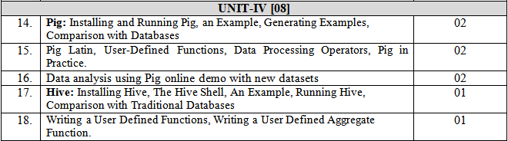

Slide 2
Hive is a framework designed for data warehousing that runs on top of Hadoop. It enables users to run queries on the huge volumes of data. Its basic function is to convert SQL queries into MapReduce jobs.

Slide 3
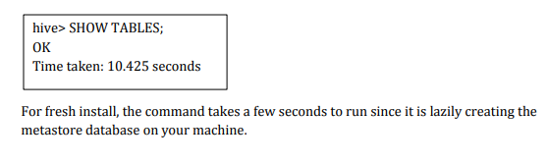
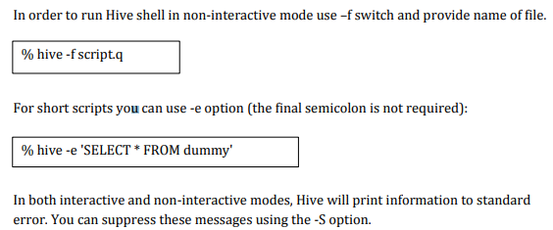

Slide 4
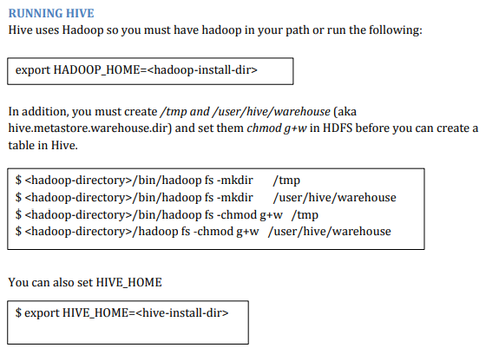

Slide 5
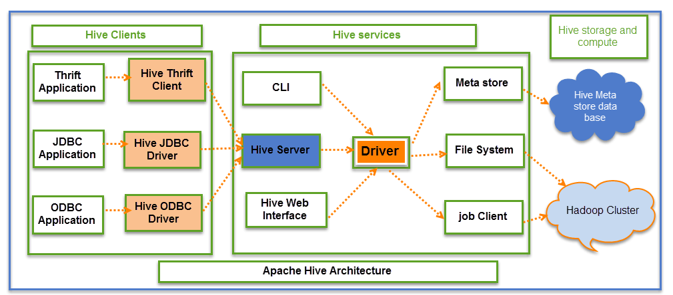

Slide 6
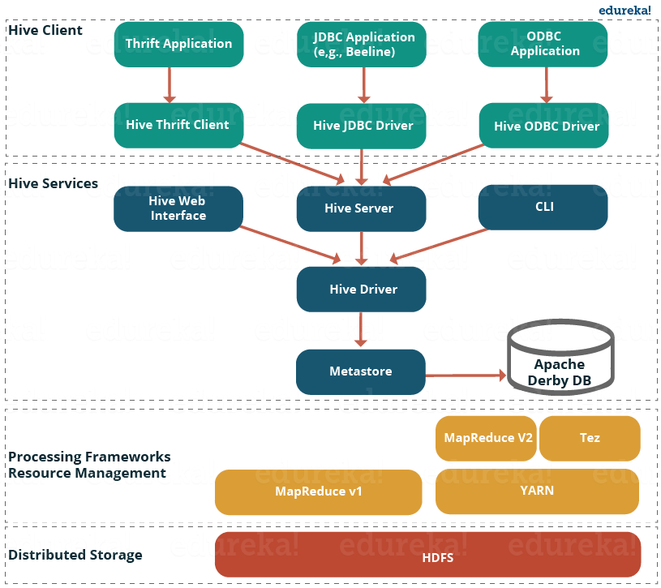

Slide 7
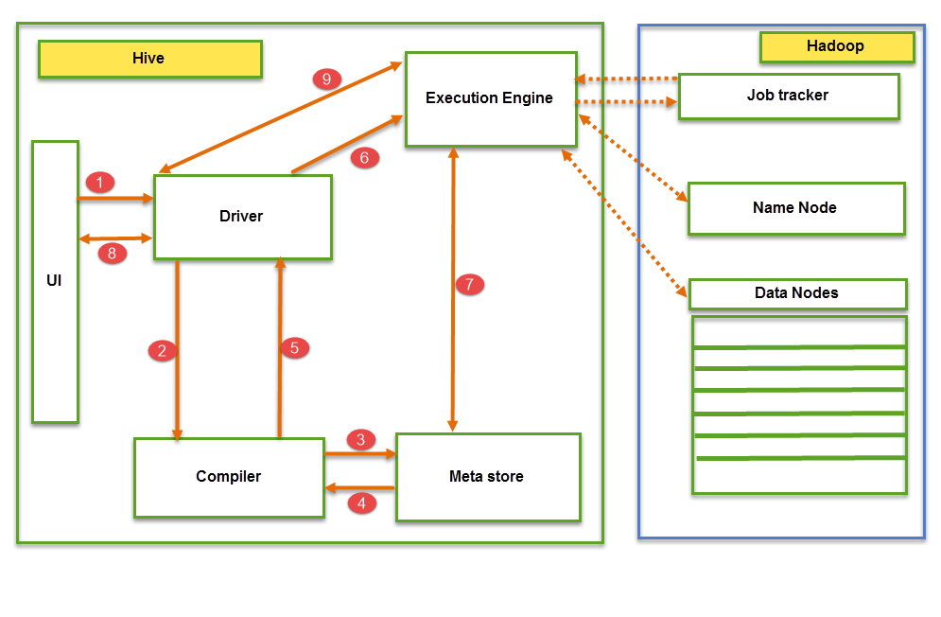

Slide 8
Flow of execution
Executing Query from the UI( User Interface)
The driver is interacting with Compiler for getting the plan. (Here plan refers to query execution) process and its related metadata information gathering
The compiler creates the plan for a job to be executed. Compiler communicating with Meta store for getting metadata request
Meta store sends metadata information back to compiler
Compiler communicating with Driver with the proposed plan to execute the query
Driver Sending execution plans to Execution engine
Execution Engine (EE) acts as a bridge between Hive and Hadoop to process the query. For DFS operations.

Slide 9
7. Fetching results from driver
8. Sending results to Execution engine. Once the results fetched from data nodes to the EE, it will send results back to driver and to UI ( front end)

Slide 10
EE
EE should first contacts Name Node and then to Data nodes to get the values stored in tables.
EE is going to fetch desired records from Data Nodes. The actual data of tables resides in data node only. It collects actual data from data nodes related to mentioned query
Execution Engine (EE) communicates bi-directionally with Meta store present in Hive to perform DDL (Data Definition Language) operations. Here DDL operations like CREATE, DROP and ALTERING tables and databases are done.
Execution Engine (EE) communicates with Hadoop daemons such as Name node, Data nodes, and job tracker to execute the query on top of Hadoop file system

Slide 11
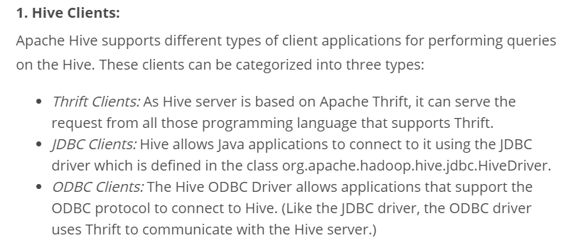
Hive Clients
Apache Hive supports different types of client applications for performing queries on the Hive. These clients can be categorized into three types:

Slide 12
2. Hive Services:
Hive CLI (Command Line Interface): This is the default shell provided by the Hive where you can execute your Hive queries and commands directly.
Apache Hive Web Interfaces: Apart from the command line interface, Hive also provides a web based GUI for executing Hive queries and commands.

Slide 13
Hive Server: Hive server is built on Apache Thrift and therefore, is also referred as Thrift Server that allows different clients to submit requests to Hive and retrieve the final result.

Slide 14
Apache Hive Driver: It is responsible for receiving the queries submitted through the CLI, the web UI, Thrift, ODBC or JDBC interfaces by a client. Then, the driver passes the query to the compiler where parsing, type checking and semantic analysis takes place with the help of schema present in the metastore.
In the next step, an optimized logical plan is generated in the form of a DAG (Directed Acyclic Graph) of map-reduce tasks and HDFS tasks.
Finally, the execution engine executes these tasks in the order of their dependencies, using Hadoop.

Slide 15
Metastore: You can think metastore as a central repository for storing all the Hive metadata information. Hive metadata includes various types of information like structure of tables and the partitions along with the column, column type, serializer and deserializer which is required for Read/Write operation on the data present in HDFS. The metastore comprises of two fundamental units:

Slide 16
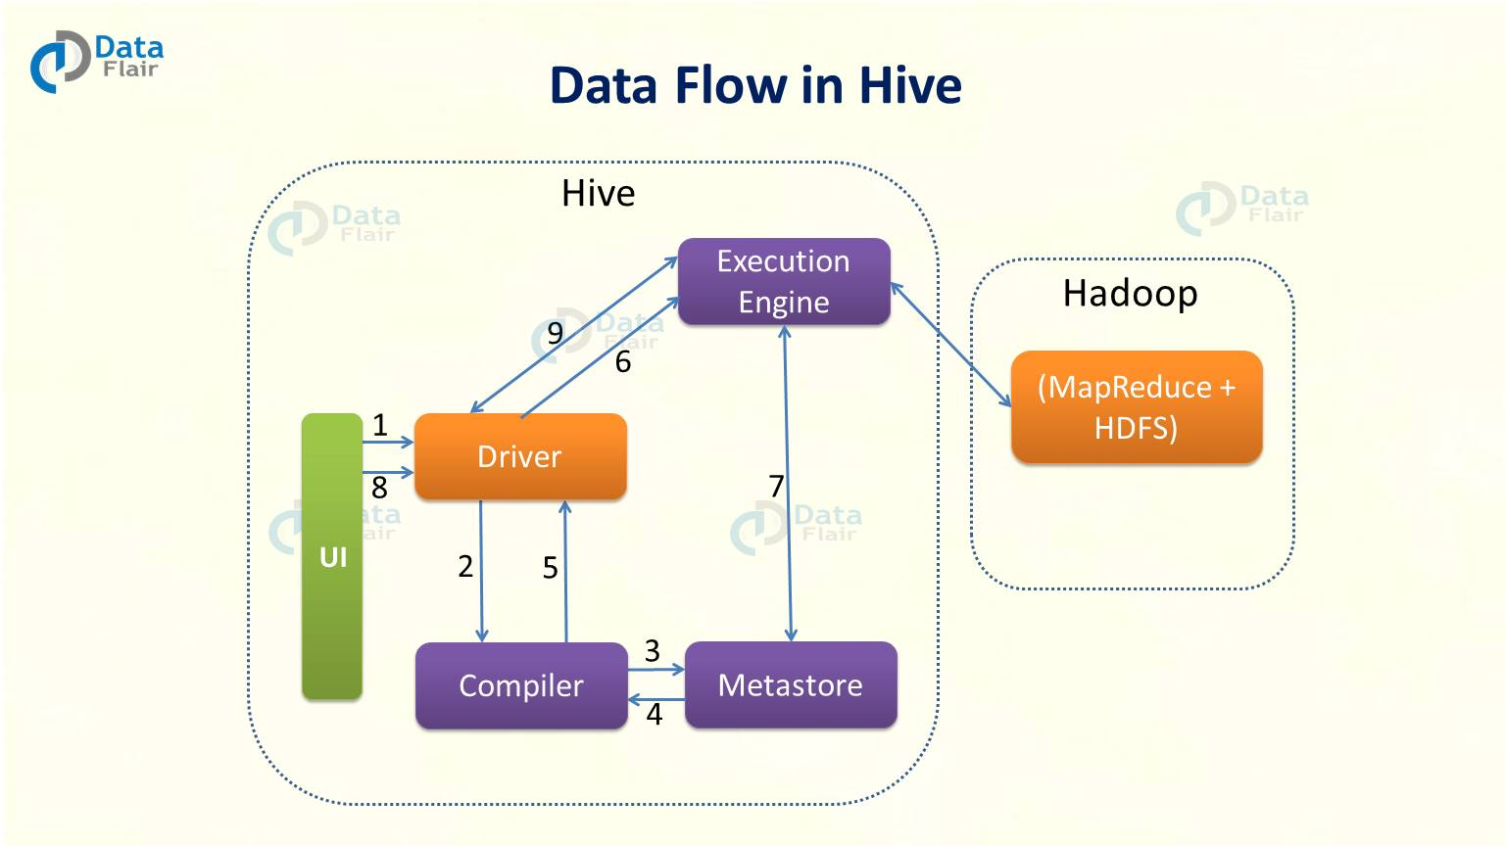

Slide 17
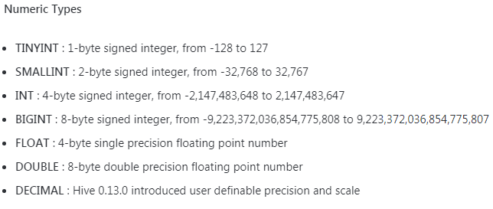
Hive types
Numeric Types

Slide 18
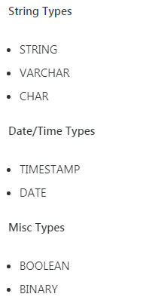
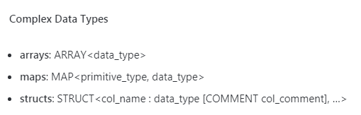

Slide 19
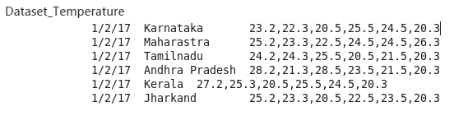

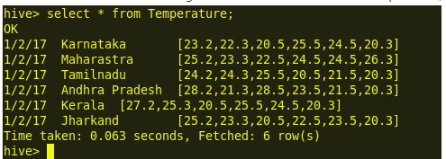

Slide 20
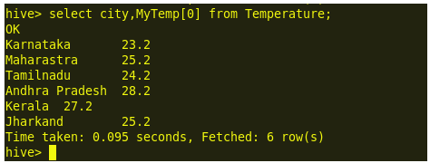
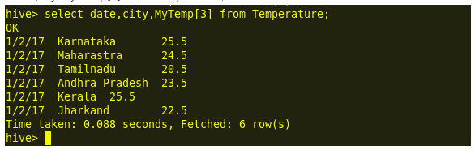

Slide 21
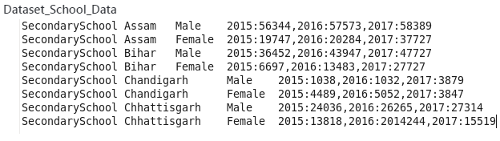
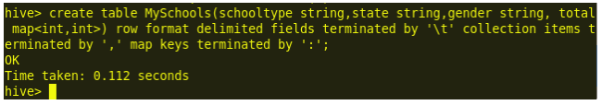
load data local inpath ‘/home/hadoop12/Desktop/School_Data.txt’ into table MySchools;

Slide 22
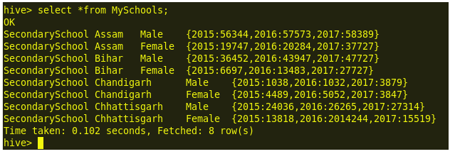
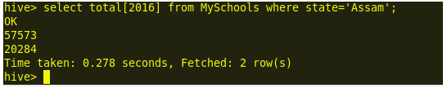

Slide 23
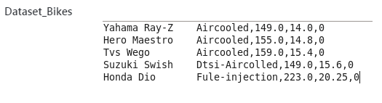
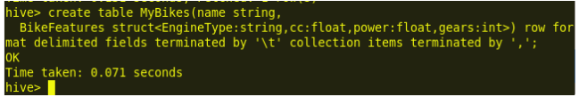
load data local inpath ‘/home/hduser12/Desktop/Bikes.txt’ into table MyBikes;

Slide 24
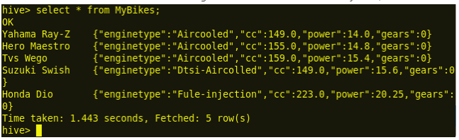
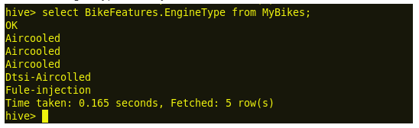


Slide 25
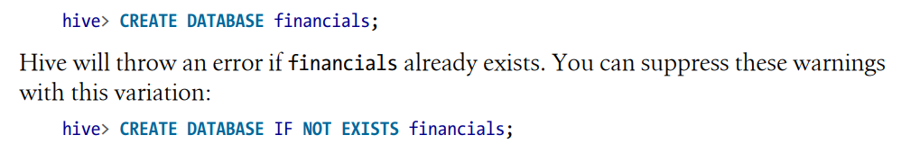
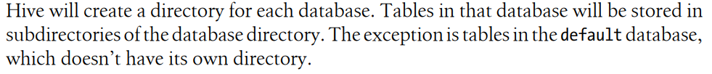
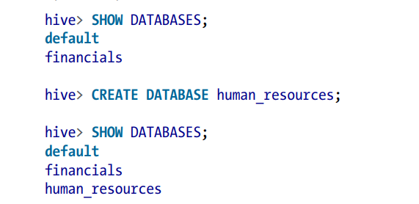

Slide 26
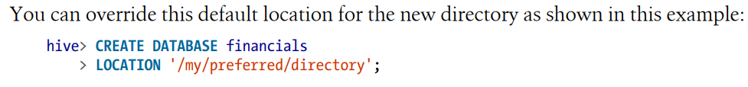
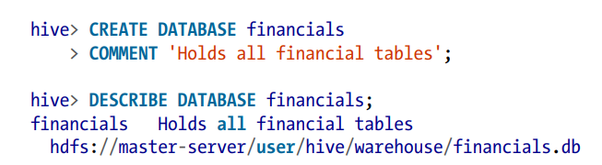

Slide 27
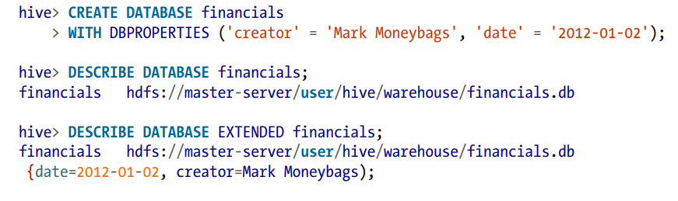
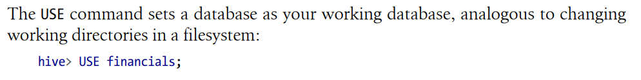

Slide 28
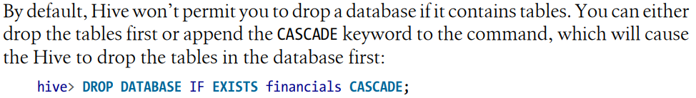
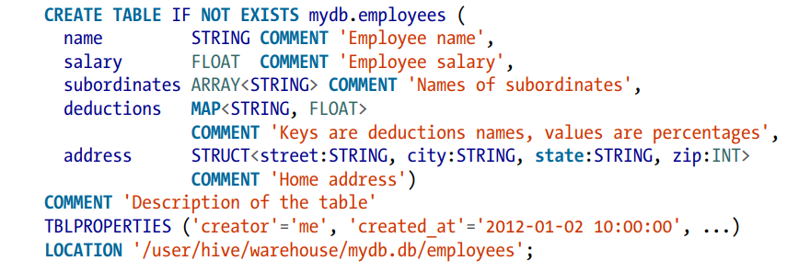
If you add the option IF NOT EXISTS, Hive will silently ignore the statement if the table already exists. This is useful in scripts that should create a table the first time they run.

Slide 29
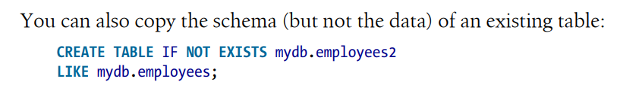
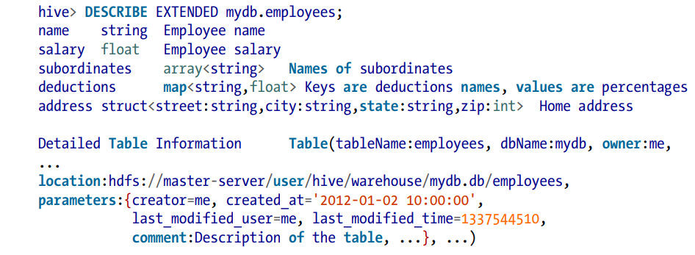

Slide 30
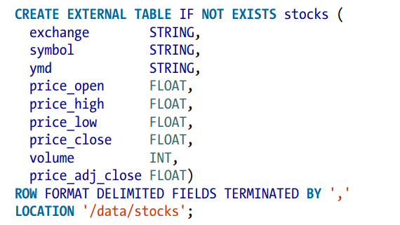

Slide 31
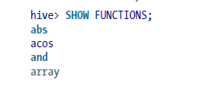
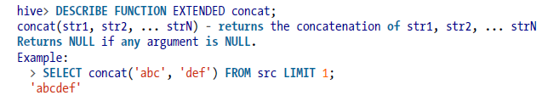
Discovering and Describing Functions

Slide 32
Calling Functions

Slide 33
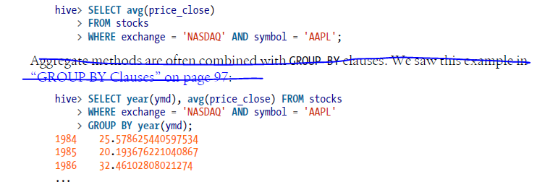
Aggregate Functions

Slide 34


Table Generating Functions

Slide 35


ORDER BY and SORT BY

Slide 36
External table
External table is created for external use as when the data is used outside Hive. Whenever we want to delete the table’s metadata and we want to keep the table’s data as it is, we use an External table. External table only deletes the schema of the table

Slide 37
managed table
A managed table is also called an Internal table. This is the default table in Hive. When we create a table in Hive without specifying it as external, by default we will get a Managed table. If we create a table as a managed table, the table will be created in a specific location in HDFS. By default, the table data will be created in /usr/hive/warehouse directory of HDFS. If we delete a Managed table, both the table data and metadata for that table will be deleted from the HDFS.

Slide 38
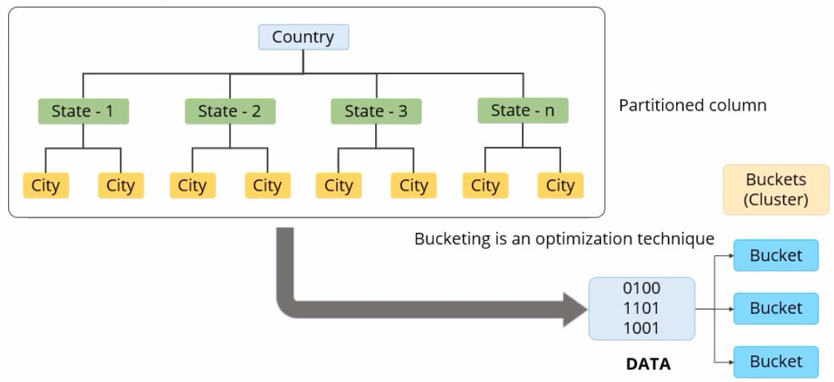

Slide 39
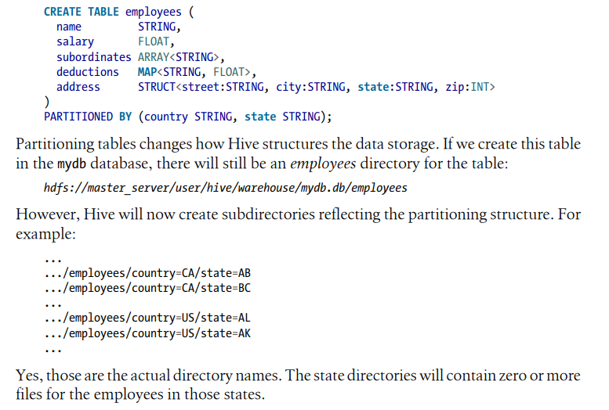
Partitioning

Slide 40
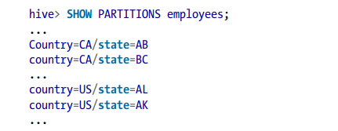

Slide 41
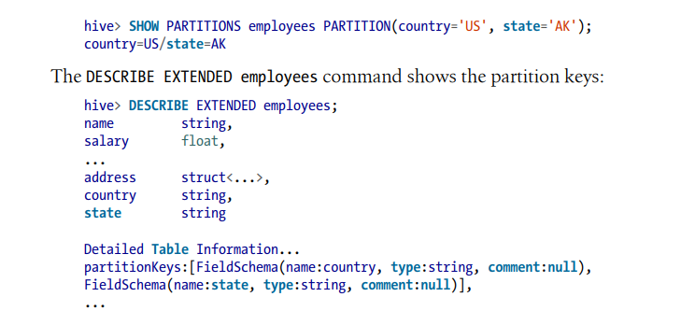

Slide 42
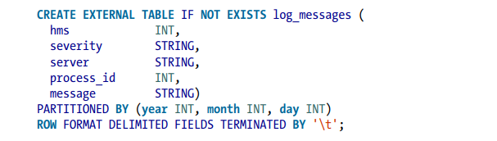
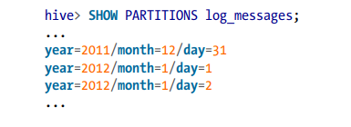
a day’s worth of log data is about the correct size for a useful partition and finer grain queries over a day’s data will be fast enough.

Slide 43

Loading Data into Managed Tables

Slide 44
Dynamic Partitioning vs static Partitioning
Partitions are created when data is inserted into the table. Depending on how you load data you would need partitions.
Usually when loading files (big files) into Hive tables static partitions are preferred.
saves your time in loading data compared to dynamic partition

Slide 45
1,Anne,Admin,50000,A,us,newyork
2,Gokul,Admin,50000,B,ind,ap
3,Janet,Sales,60000,A,us,texas
4,Hari,Admin,50000,C,ind,ts
5,Sanker,Admin,50000,C,ind,tn
6,Margaret,Tech,12000,A,eng,london
7,Nirmal,Tech,12000,B,ind,ap
8,jinju,Engineer,45000,B,ind,ts
9,Nancy,Admin,50000,A,eng,london
10,Andrew,Manager,40000,A,eng,london
11,Arun,Manager,40000,B,ind,ap
12,Harish,Sales,60000,B,ind,ap
13,Robert,Manager,40000,A,us,texas
14,Laura,Engineer,45000,A,us,texas
15,Anju,Ceo,100000,B,ind,ts
16,Aarathi,Manager,40000,B,ind,ap
17,Parvathy,Engineer,45000,B,ind,ts
18,Gopika,Admin,50000,B,ind,ap
19,Steven,Engineer,45000,A,ind,ap
20,Michael,Ceo,100000,A,us,newyork

Slide 46
PARTITION THIS DATASET INTO 3 DEPARTMENTS A,B,C
create table emp_inf_partition(
employeeid int,
firstname string,
designation string,
salary int,
country string,
state string)
PARTITIONED BY (department String)
row format delimited fields terminated by ",";

Slide 47
INSERT department ‘A’ DATA FROM STAGING TABLE emp_stg into partitioned table emp_inf_partition
INSERT INTO TABLE emp_inf_partition PARTITION(department='A')
SELECT employeeid,firstname,designation,salary,country,state
FROM emp_stg WHERE department='A';

Slide 48
INSERT department ‘B’ DATA FROM STAGING TABLE emp_stg into partitioned table emp_inf_partition
INSERT INTO TABLE emp_inf_partition PARTITION(department='B')
SELECT employeeid,firstname,designation,salary,country,state
FROM emp_stg WHERE department='B';

Slide 49
INSERT department ‘C’ DATA FROM STAGING TABLE emp_stg into partitioned table emp_inf_partition
INSERT INTO TABLE emp_inf_partition PARTITION(department='C')
SELECT employeeid,firstname,designation,salary,country,state
FROM emp_stg WHERE department='C';

Slide 50
Note
If we go for the approach shown in last three slides, if we have 50 partitions we need to do the insert statement 50 times.

Slide 51
Drop all partitions
ALTER TABLE emp_inf_partition
DROP IF EXISTS PARTITION (department='A') ;
ALTER TABLE emp_inf_partition
DROP IF EXISTS PARTITION (department='B') ;
ALTER TABLE emp_inf_partition
DROP IF EXISTS PARTITION (department='C') ;
select * from emp_inf_partition;

Slide 52
Dynamic partitions
In order to achieve Dynamic Partition, we need to set 4 things.
By default, Dynamic Partition is disabled till HIVE 2.0 to prevent accidental creation of partitions
So In order to achieve Dynamic Partition we need to set 4 things through Hive shell or hive-site.xml

Slide 53
set hive.exec.dynamic.partition=true;
set hive.exec.dynamic.partition.mode=nonstrict;
set hive.exec.max.dynamic.partitions=1000;
set hive.exec.max.dynamic.partitions.pernode=100;

Slide 54
CREATE An NON PARTITIONED TABLE TO STORE THE DATA (STAGING TABLE)
create table emp_stg
(
employeeid int,
firstname string,
designation string,
salary int,
department string,
country string,
state string
)
row format delimited fields terminated by ",";
--LOAD DATA INTO TABLE emp_stg
LOAD DATA local inpath '/home/data/emp_inf_dept_data.txt' INTO TABLE emp_stg

Slide 55
INSERT DATA FROM STAGING TABLE emp_stg into partitioned table emp_inf_partition
INSERT INTO TABLE emp_inf_partition PARTITION(department)
SELECT employeeid,firstname,designation,salary,country,state,department FROM emp_stg;

Slide 56
Hive Dynamic Partitioning
Single insert to partition table is known as a dynamic partition.
Usually, dynamic partition loads the data from the non-partitioned table.
Dynamic Partition takes more time in loading data compared to static partition.
When you have large data stored in a table then the Dynamic partition is suitable.
If you want to partition a number of columns but you don’t know how many columns then also dynamic partition is suitable.
we can’t perform alter on the Dynamic partition.
You can perform dynamic partition on hive external table and managed table.
If you want to use the Dynamic partition in the hive then the mode is in non-strict mode.
Here are Hive dynamic partition properties you should allow

Slide 57

Inserting Data into Tables from Queries

Slide 58
UDFs in Hive

Slide 59
custom functions in hive when we are not able to get the desired result from hive built in functions.
There are three kind of UDFs in Hive
1.Regular UDF,
2. User Defined Aggregate Function (UDAF)
3.User Defined Tabular Function (UDTF)

Slide 60
1.Regular UDF
Acts on a single row in a table and produces a single row as output. It’s one to one relationship between input and output of a function.
e.g Hive built in TRIM() or Upper() function

Slide 61
example
Find the maximum marks obtained out of four subjects by an student.
Sample schema: STUD_ID, NAME, CLASS, TOT_MARKS, MATH, ENGLISH, PHYSICS, SOCIAL_STUDY, YEAR

Slide 62
Step 1: Create Hive Student Table
CREATE TABLE `student`(
stud_id int,
name string,
class int,
tot_marks double,
math double,
english double,
physics double,
social_study double,
year string
)
ROW FORMAT DELIMITED
FIELDS TERMINATED BY '\t' ;

Slide 63
Step 2: Load Data into Student Table
LOAD DATA LOCAL INPATH '/home/hduser12/data/student_data.txt' OVERWRITE INTO TABLE
101,tom,9,358,85,95,86,92,2015
102,racky,9,360,90,90,90,90,2015
103,marrie,9,370,92,94,94,90,2015
104,harry,9,365,88,88,89,90,2015
105,rosy,9,350,90,80,90,90,2015

Slide 64
Steps to Create & Execute UDFs in Java
Step1: We have to extend a base Class UDF to write our business logic in Java. Step2: In order to write business logic , we have to overload a method called evaluate() inside our class.

Slide 65
package com.hive.udf;
import org.apache.hadoop.hive.ql.exec.UDF;
public class GetMaxMarks extends UDF{
public double evaluate (double math,double eng,double physics,double social)
{
double maxMarks=math;
if(eng>maxMarks)
{
maxMarks = eng;
}
if(physics>maxMarks)
{
maxMarks=physics;
}
if(social>maxMarks)
{
maxMarks=social;
}
return maxMarks;
}
}

Slide 66
Step3: Now go to hive shell and type following command.
ADD JAR /usr/lib/hive/lib/hiveudfmaxmarks.jar;
CREATE temporary function GetMaxMarks as 'com.hive.udf.GetMaxMarks';

Slide 67
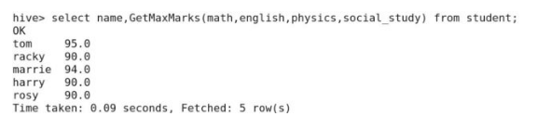
Final Step Trigger function GetMaxMarks
Final Step Trigger function GetMaxMarks

Slide 68
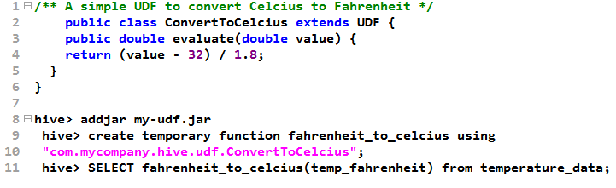

Slide 69
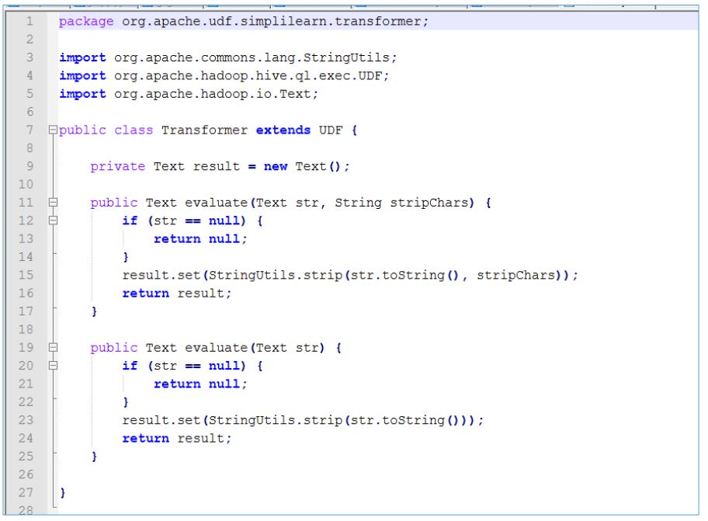

Slide 70
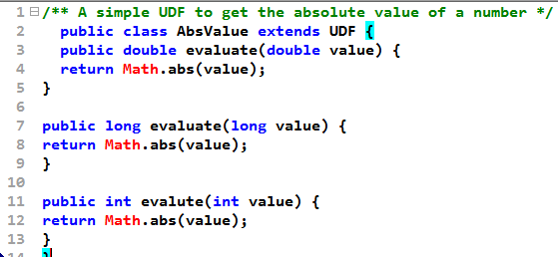

Slide 71
Questions and answer go through for slip2
https://books.google.co.in/books?id=a0VHDwAAQBAJ&pg=SA3-PA43&lpg=SA3-PA43&dq=page_view_stg&source=bl&ots=b_y0pHjvG4&sig=ACfU3U0sVAxdwjsG7eGEWTDZo5G2X6JFbA&hl=en&sa=X&ved=2ahUKEwip3eOpydTkAhWm73MBHWZ-DvgQ6AEwFnoECAgQAQ#v=onepage&q=page_view_stg&f=false

